Slide 1

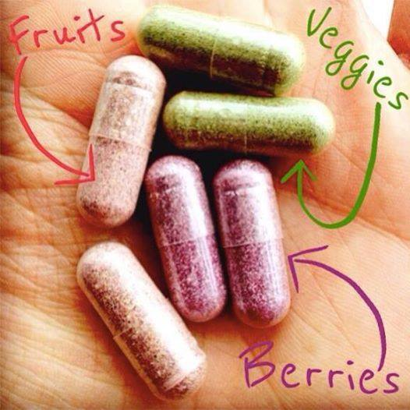

You are cordially
invited to
Wine & Wellness
from the
Vineyard, Orchard & Farm
to your Table
Simple Steps & Simple Solutions
+ increase your family’s nutrition
+ easily make healthier choices
+ your kids want to eat veggies
+ reduce doctor’s visits
+ abundant health for everyone
Wednesday, Aug. 27th @ 6:30pm
(bring your kids!)
1843 E. Haystacker Drive, Eagle, CO 81631
RSVP: 970/328-0353 or jp@dalys.com

